Slide 1
Spirituality Twilight
17th April 2024
Our Catholic Mission Statement
Working in a Catholic School
The importance of the Virtue Pairs in shaping the above

Slide 2
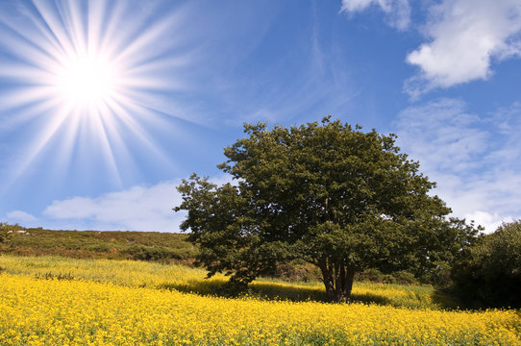
Jesus said to His disciples,
“What can we say the kingdom of God is like? It is like a mustard seed which, at the time of its sowing in the soil, is the smallest of all the seeds on earth; yet once it is sown, it grows into the biggest shrub of them all and puts out big branches so that the birds of the air can shelter in its shade.” Mark 4:30-32

Slide 3
St Mary’s…
Strong reputation locally
Uniform
Well regarded post - 16
Good results
Popular choice with prospective parents
Oversubscribed

Slide 4
Our Mission Statement
St. Mary’s exists to serve the Catholic communities of Hereford, Ross, Ledbury, Leominster and surrounding areas. We are here to educate the children in a community which has Gospel values, traditions and beliefs of the Roman Catholic Faith as the kernel of its ethos.

Slide 5
The mission of the school is:
To develop an understanding and love of the Catholic faith in our school community enabling all to grow in the appreciation that the school is a community of believers.
To value the contribution that all staff bring, knowing that together we strive to build the Kingdom of God.
To foster the integration of various aspects of human development – spiritual, moral, emotional, social, physical and intellectual.
To maintain practical support, guidance and affirmation for all in the school community.
To prepare pupils for their future life in today’s world.

Slide 6
Foster
Love
‘MISSION’
Grow
Prepare
Develop
Value

Slide 7
To achieve these aims the School will:
Have an R.E. Programme which encourages faith development and meets the directives of Church authorities.
Have opportunities to experience what it is to be part of a Worshipping Community.
Develop appropriate systems whereby each individual feels a sense of justice, love and value.
Support initiatives which train pupils to develop as independent young adults able to take responsibility.
Co-operate in the formation of meaningful cross-curricular links.

Slide 8
Spirituality Inset
17th April 2024

Slide 10
Grateful for their own gifts, for the gift of other people, and for the blessings of each day; and generous with their gifts, becoming men and women for others.
Attentive to their experience and to their vocation; and discerning about the choices they make and the effects of those choices.
Compassionate towards others, near and far, especially the less fortunate; and loving by their just actions and forgiving words.
Faith-filled in their beliefs and hopeful for the future.
Eloquent and truthful in what they say of themselves, the relations between people, and the world.
Learned, finding God in all things; and wise in the ways they use their learning for the common good.
Curious about everything; and active in their engagement with the world, changing what they can for the better.
Intentional in the way they live and use the resources of the earth, guided by conscience; and prophetic in the example they set to others.

Slide 11
What are the virtue pairs & why do we use them?
The virtues originate from the intellectual and moral virtues.
These pairs come from Jesuit schools to try to articulate the Gospel virtues.
The Archdiocese want all it’s schools to promote and TEACH our students these virtues.
The virtues are not, of course, unique to Catholic schools – these words come from our tradition but are fundamentally human virtues shared by all human beings!

Slide 12
Discussion
Within your groups, discuss how the selected virtues can be a positive factor and a strength in:
Your teaching / Your role as a teacher
Compassionate and Loving
Grateful and Generous
Attentive and Discerning
Intentional and Prophetic

Slide 13
Discussion
Groupings
Ideally….
groups should be between 4 and 6 in number
groups should be cross-curricular

